Slide 1


Sneeze-Free Zones,
a Grandma-Approved
Travel Guide
Team 3
12-02-2024
KK

Slide 2
Daniel Allen, Head Engineer
Kiley Karecki, Project Manager
Israel Flores, Backend Development
Huiyan (Annie) Ouyang, Data Visualization Specialist
Saswata Chakraborty, Data Analyst
Team Members:
KK

Slide 3
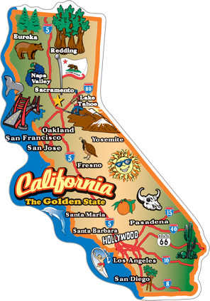

Vacation time is here, but so is Flu Season
Objective: Travel by car from Los Angeles, CA to visit Grandma in Miami Beach, FL somewhere between March 9 to May 4 for Season 2023-24
KK

Slide 4

https://gis.cdc.gov/grasp/fluview/fluportaldashboard.html
KK

Slide 5
SQLite, and why?
Works well for low to medium traffic websites
Easily handles the 1300 data points we used
Ideal for building and testing the project without needing a remote database
KK

Slide 6
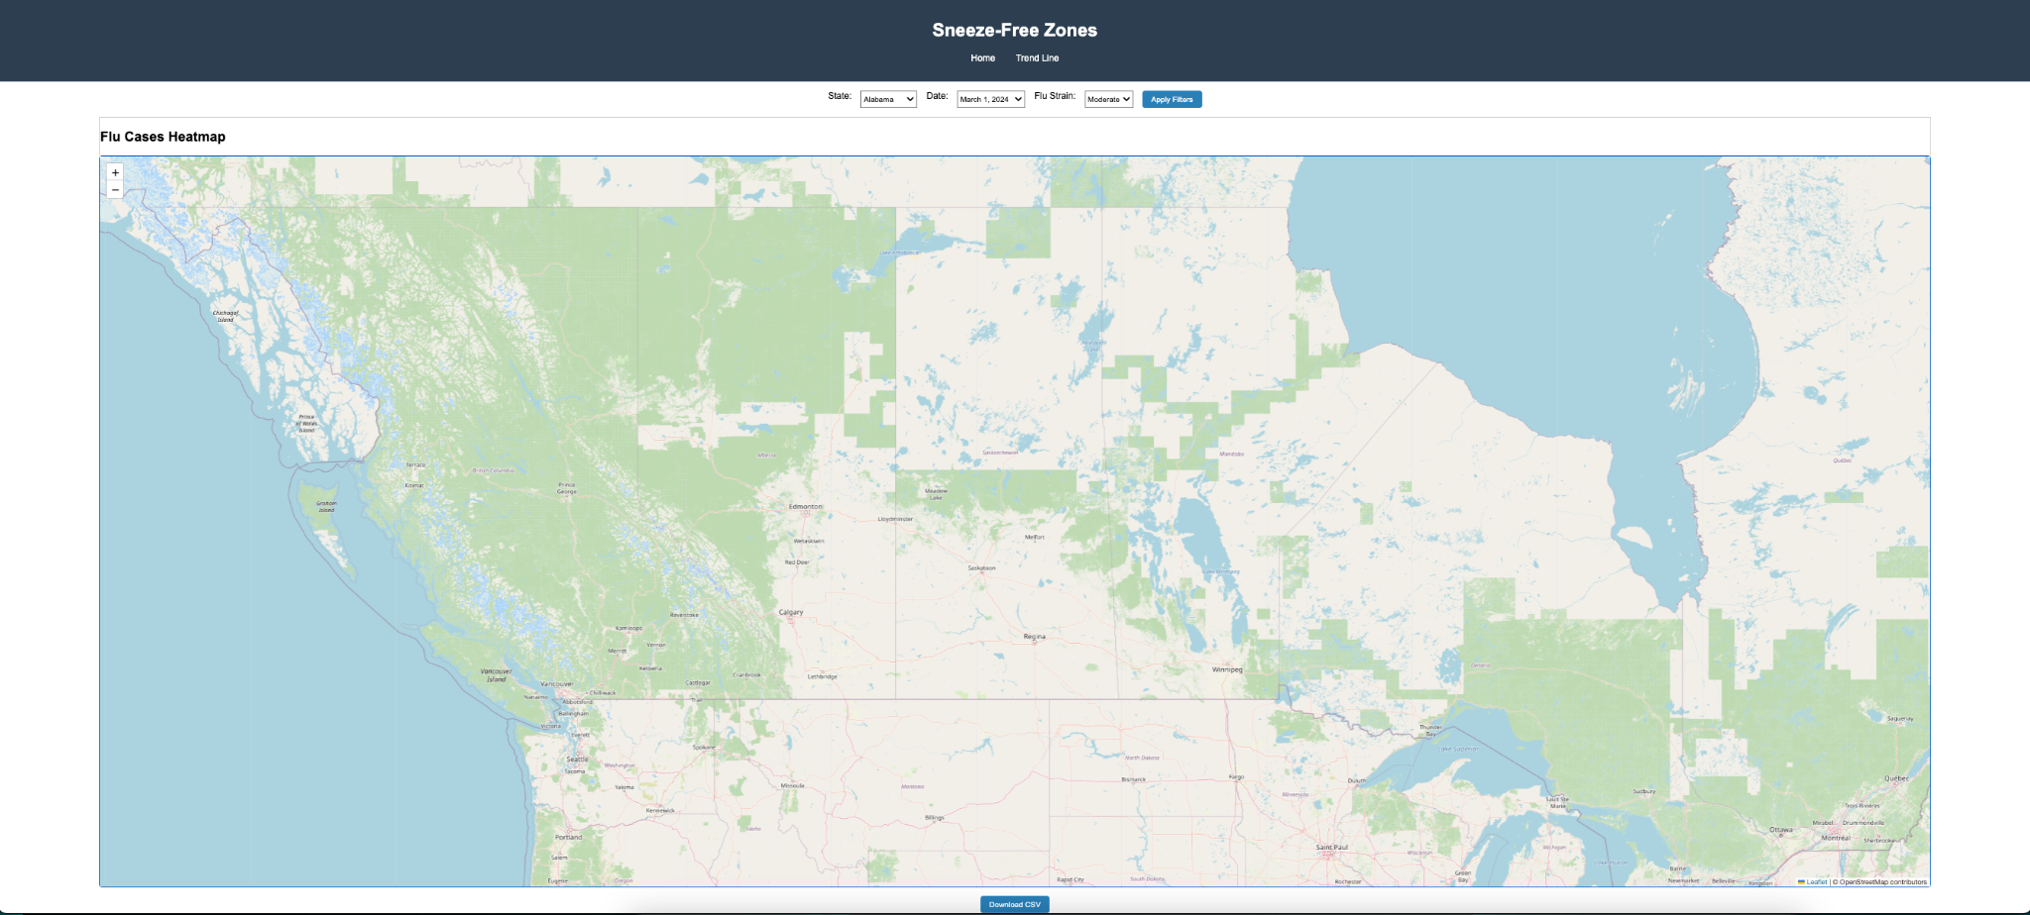

Slide 7
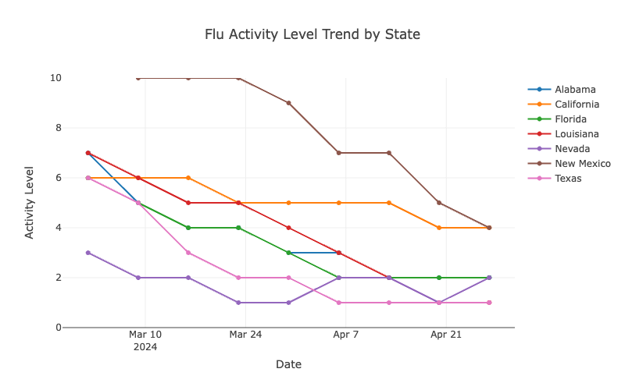
New Mexico had the highest flu activity but showed a steady decline.
California and Florida had moderate initial activity levels but reduced substantially over time.
Texas exhibited consistently low flu activity levels.
Other states (Alabama, Louisiana) followed varying declining trends.
HO

Slide 8
Coding the Map
DA
Leaflet: used for interactive mapping and dynamic visualizations
D3: added to provide additional data visualizations and manipulation of the map
Flask: used on the backend to help serve data and visualizations, this was used alongside Python

Slide 9
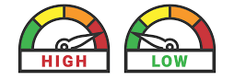
What’s on the Heat Map?
DA
Each major city in the Southern US is tracked with data showing the city and state name, acuity level (a measure of the severity of a patient's illness or medical condition), and activity level (low, minimal, moderate, high, and very high)

Slide 10
Let’s find out, did we make it to Grandma in Miami Beach without getting sick?
DA

